Slide 1
Presentation on
“BASICS OF ROCKETRY”
&
“PARACHUTE RECOVERY”

Slide 2
TEAM 8
TEAM MEMBERS
1-HITAISH KUMAR
2-SAHARSH PANDA
3-CHINMAYA PRADHAN
4-NIHAR RANJAN
5-ANINDIT SAHU
6-SHIBASAKTI BAHUBALINDRA

Slide 3
CONTENTS
1-Types of Rockets
2-Principle of Rockets
2-Phases of rocket
3-Components of Rocket
4-Propulsion system
5-Stability
6-Flight
7-Performance
8-Parachute Recovery

Slide 4
Types of rockets
1-Space Vehicles
2-Sounding rockets
3-Missiles
4-Amateur

Slide 5
Principle of rocket
ROCKET is a machine that develops thrust by rapid expulsion of matter.
1-It differs from other engines in that it carries its fuel internally which would burn in space as well as on Earth.
2-The ROCKET is called Launch vehicle when it is use to launch satellite or payload to Space.
3-It becomes a missile when it carries warhead as payload.

Slide 6
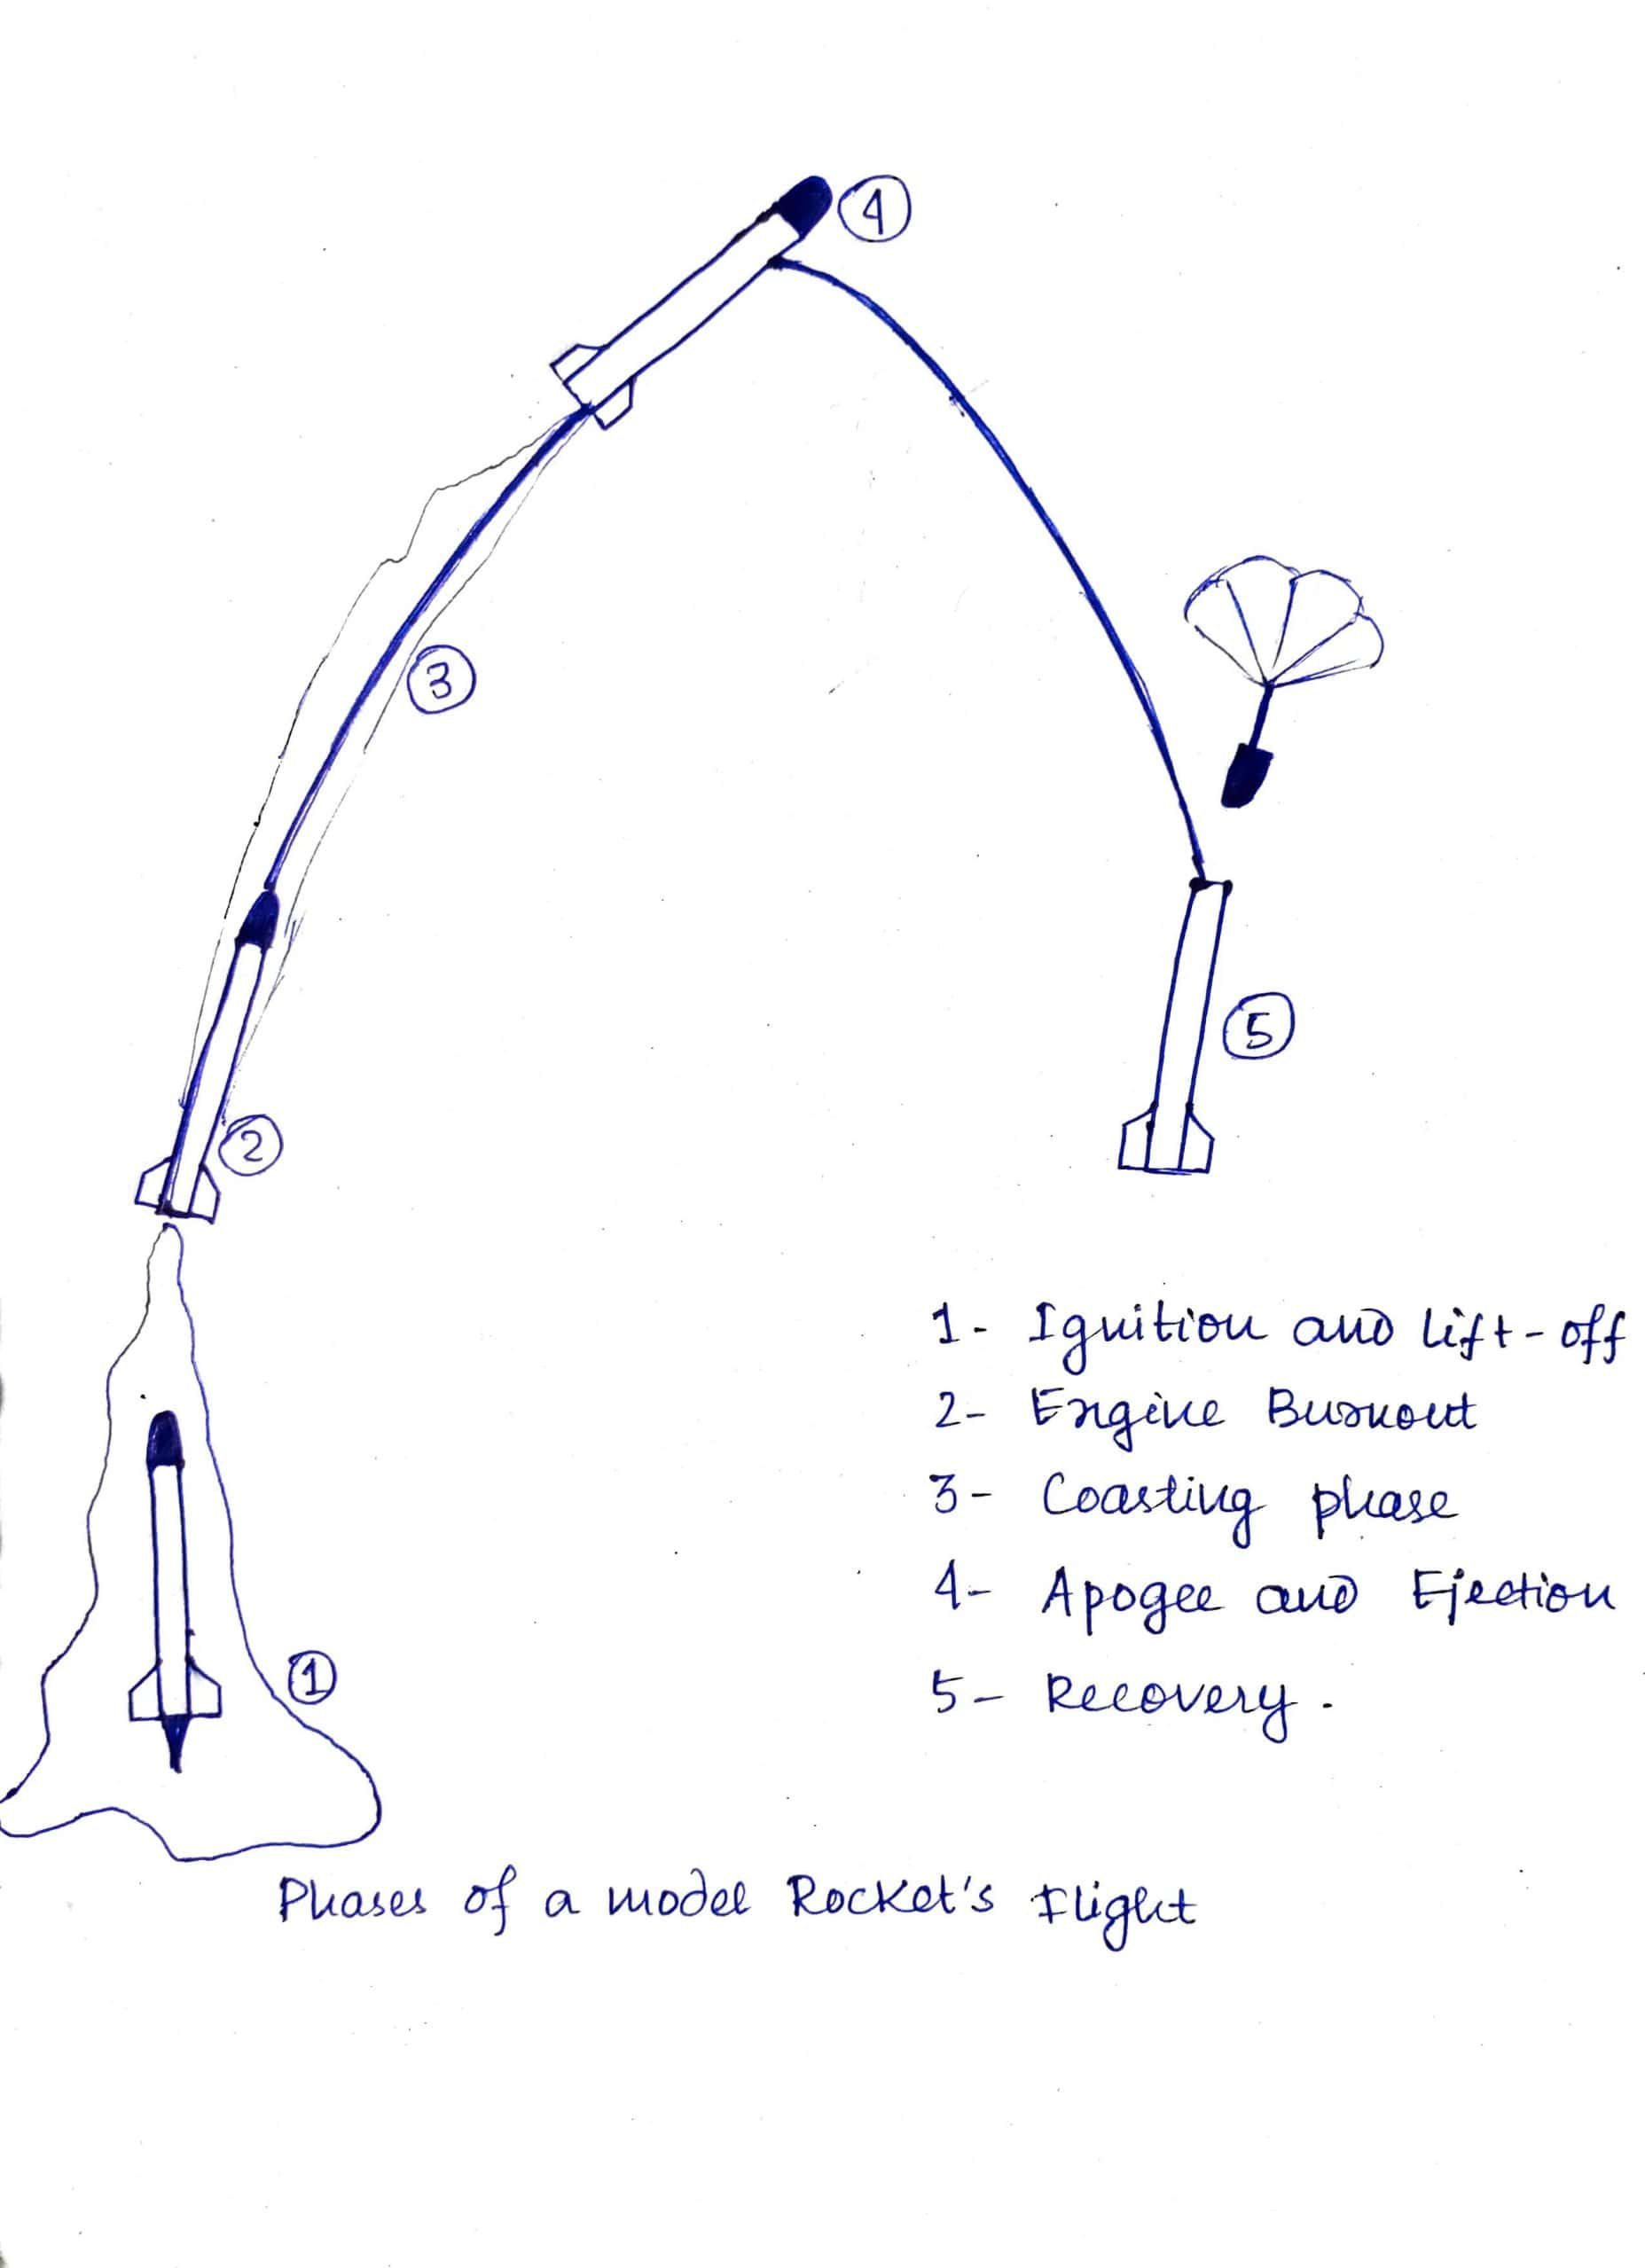
Phases of rocket

Slide 7
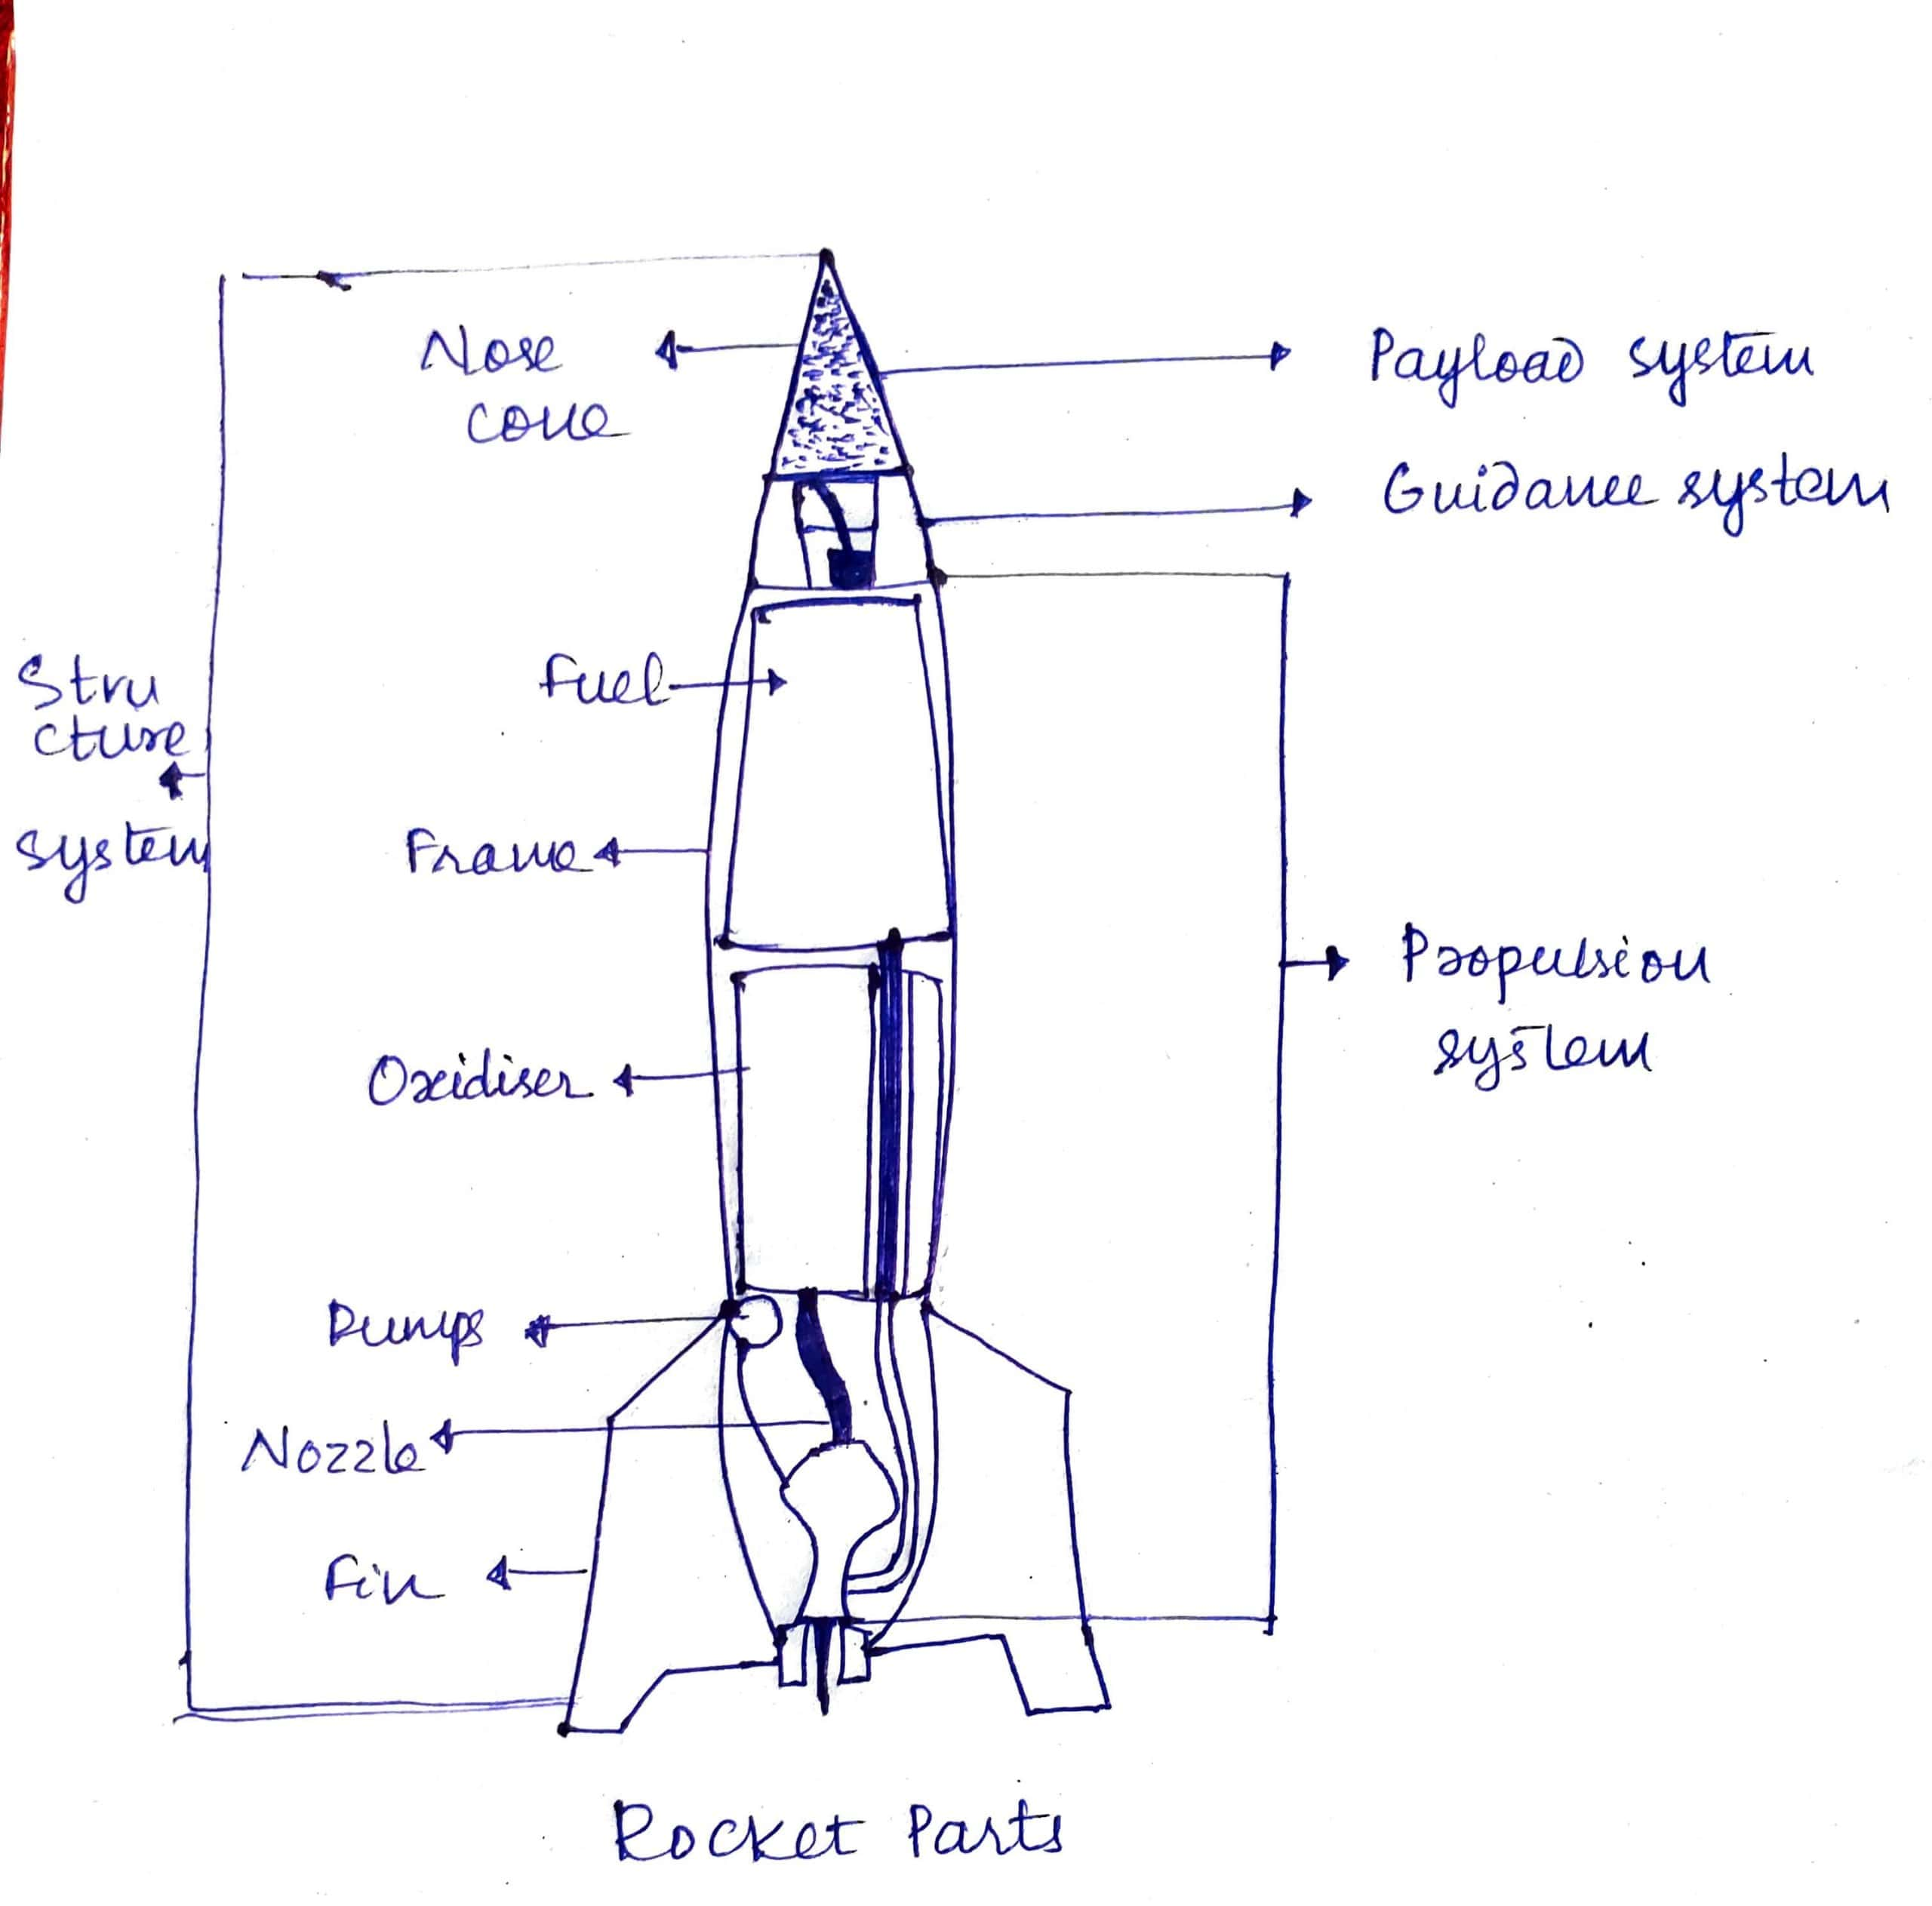
Components of a rocket

Slide 8
Propulsion system
1-It follows NEWTON’S THIRD LAW of motion.
2-Rocket motor is the energy conversion device where matter(rocket propellent) is burned to produce hot gases.
3-These are forced out through a nozzle to build pressure.
4-Rocket propellent consist of:
-Fuel
-Oxidizer
5-Rocket motor types:
-Liquid propellent (alcohol,H2O2)
-Solid propellent (black powder, aluminum perchlorate)
-Hybrid propellent (plastic,NO2)

Slide 9
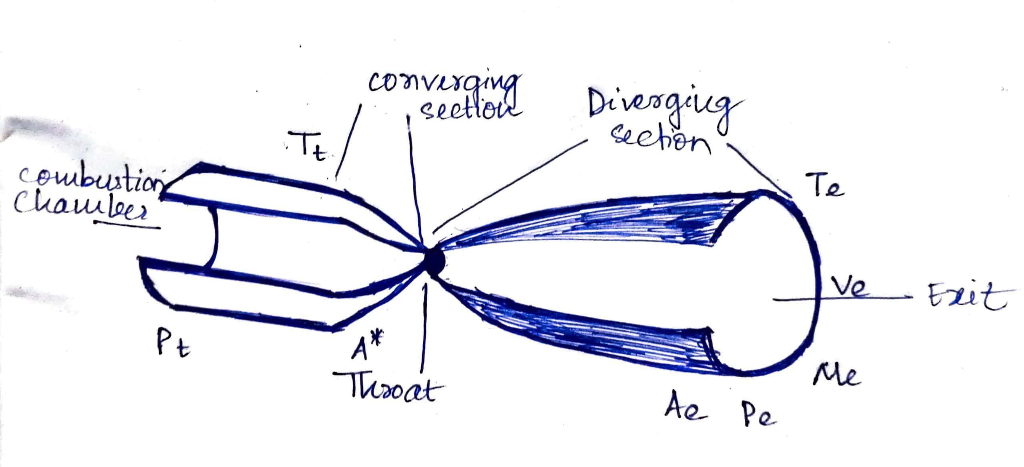
Thrust= F= Me*Ve + (Pe - Po)Ae
where Me =mass flow rate
Pe = pressure inside nozzle
Po = atmospheric pressure
Ae = area
Ve = velocity

Slide 10
stability
Defined by relationship between Centre of Gravity(COG) and Centre of Pressure(COP)
1-To be stable COG must be in front of COP.
2-As propellent burns away, COG moves forward resulting in its stability during flight.
3-During flight it may rotate due to wind which will push COG backwards.
4-We can make rocket stable by adding weight in front of rocket(COG forward), enlarging or moving the fins further(moves COP further).

Slide 11
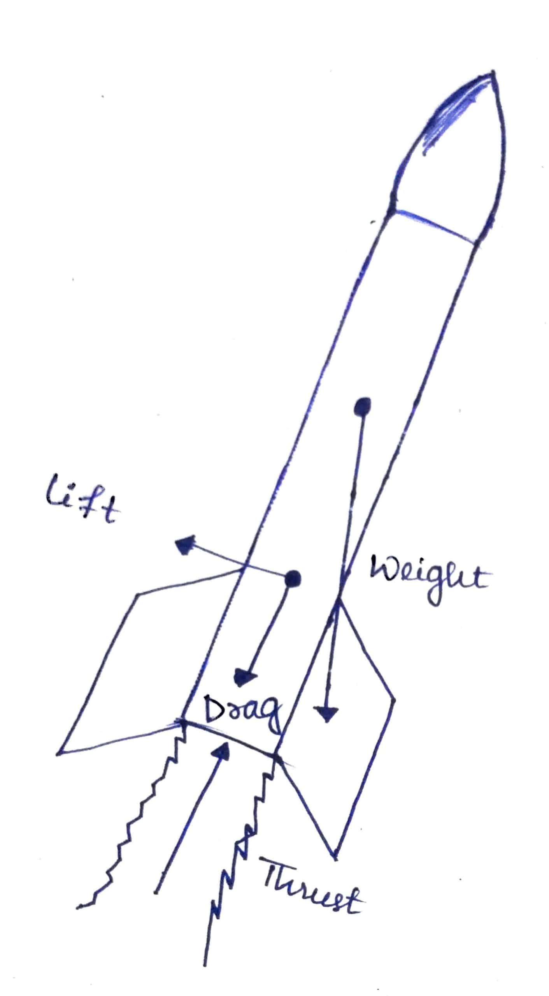
flight
Forces affecting during flight:
1-Thrust
2-Weight
3-Drag
4-Lift
Factors determining altitude:
1-Daimeter
2-Weight
3-Velocity
4-Motor burn characteristics

Slide 12
ROCKET PERFORMANCE
1-Simulators are available to predict its performance with given design and various parameters.
2-Ex : RockSim, SpaceCAD, VCP etc.

Slide 13
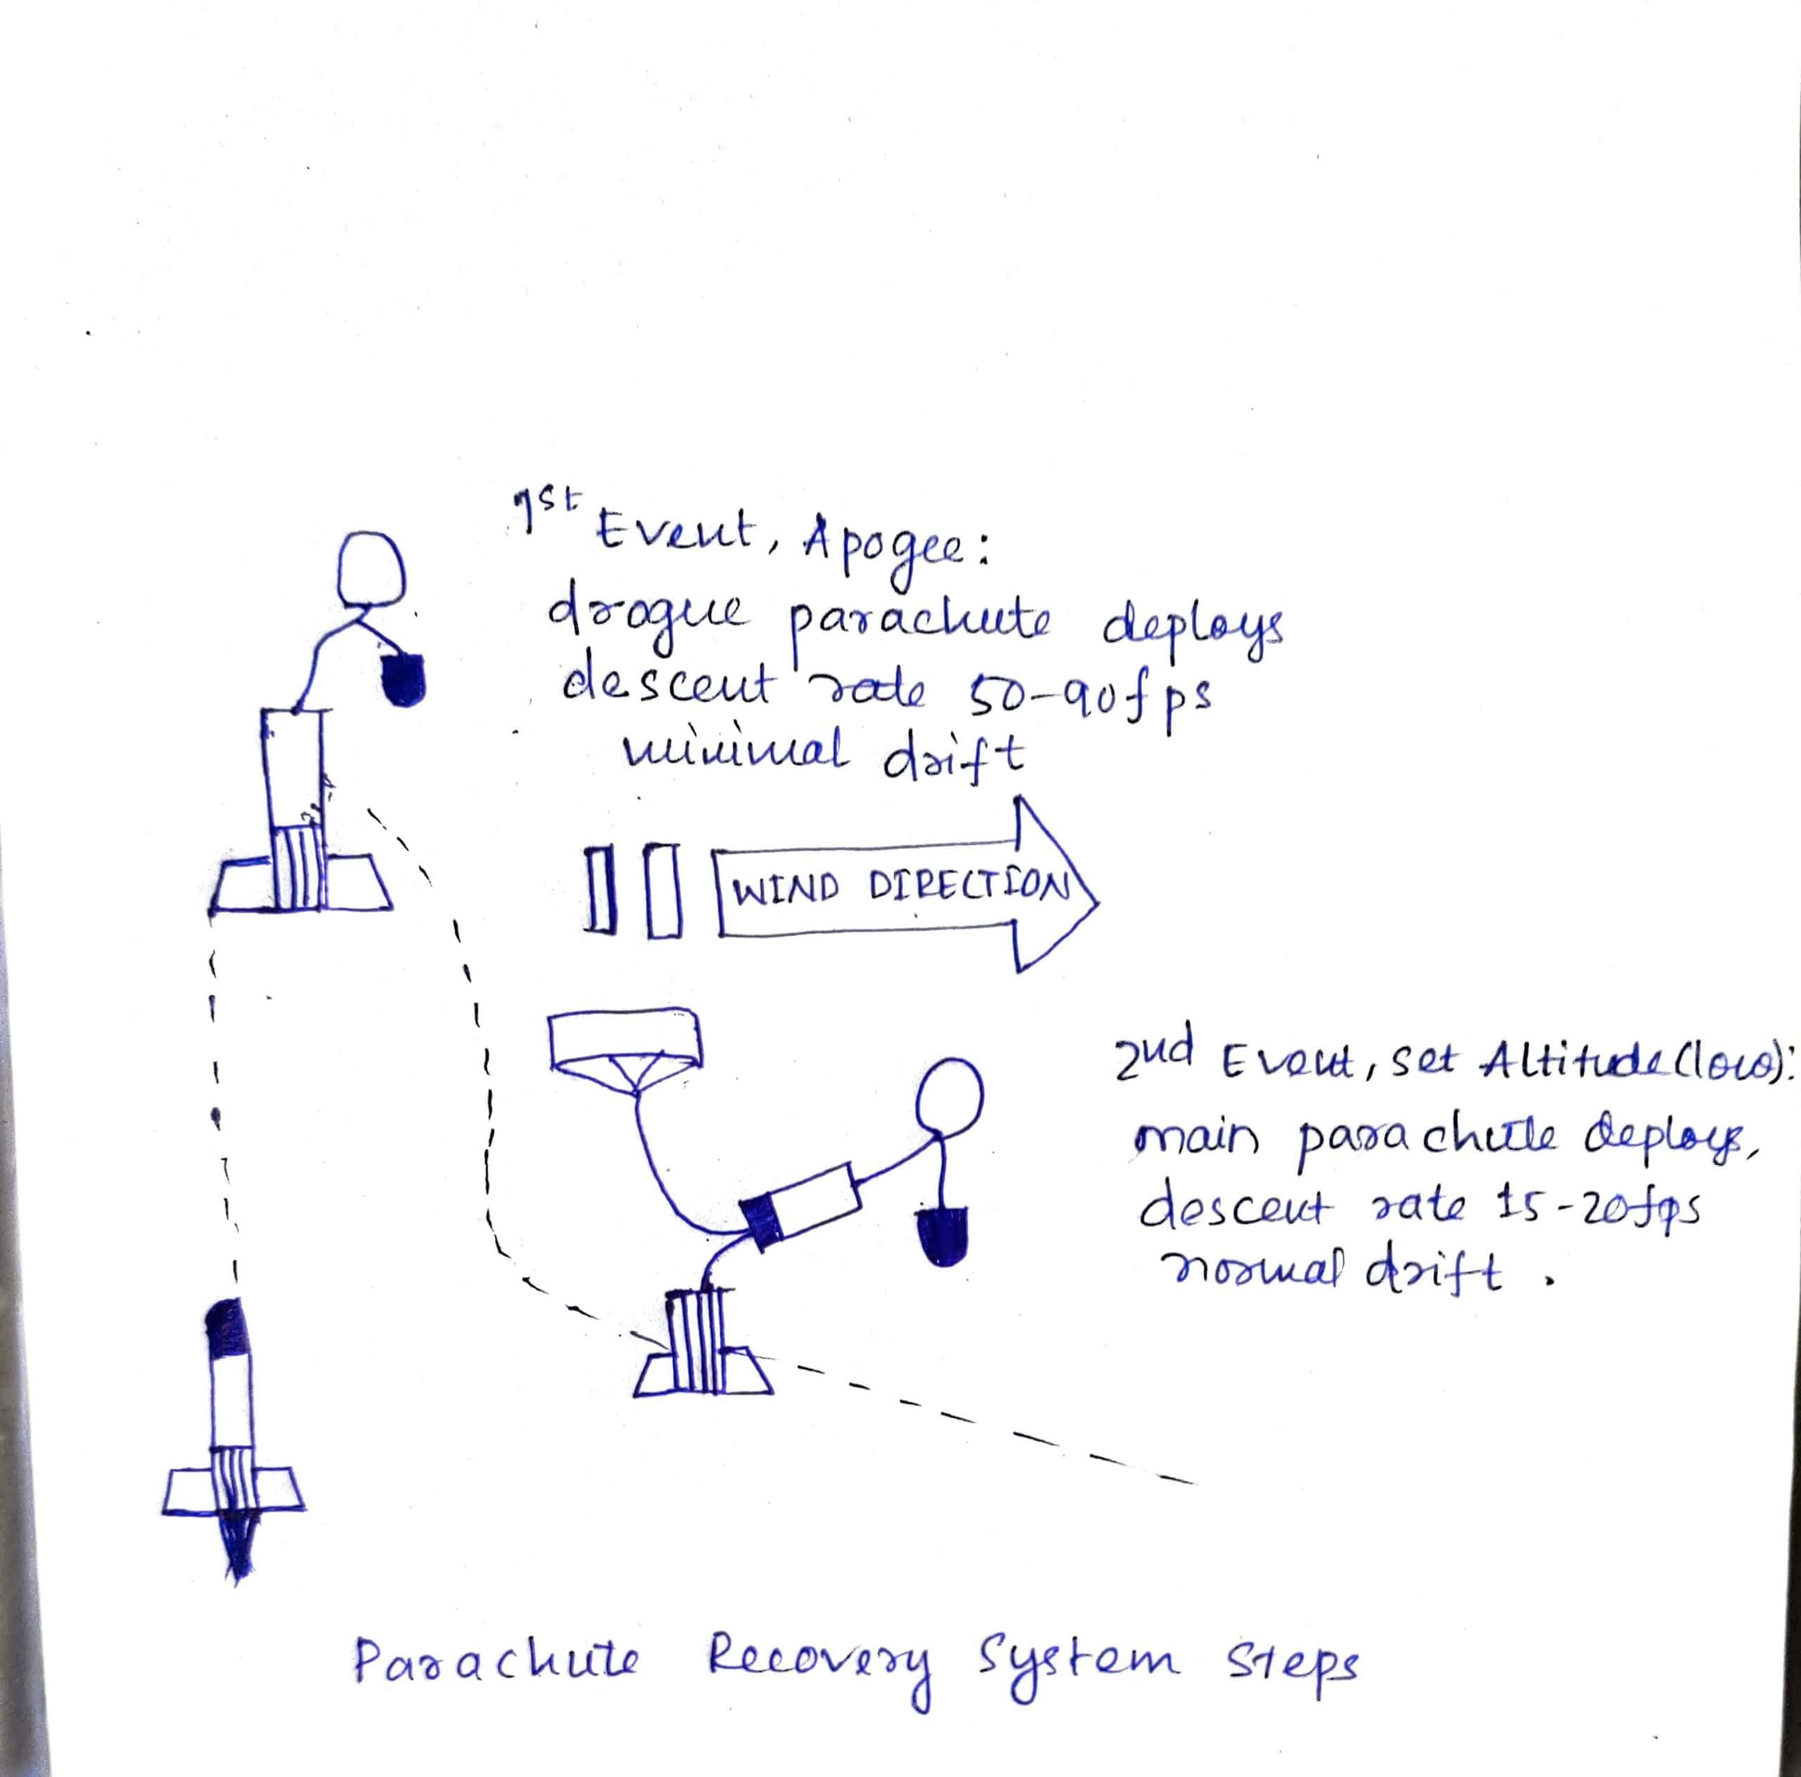
Parachute recovery
1-These factors are considered for parachute design:
-Shock a rocket can withstand after hitting ground
-Payload + Parachute weight allowed
-Descent speed under parachute

Slide 14
2-The maximum descent speed is found out using v=root over(2gH)
3- As per general rule of thumb, descent velocity ranges from 3.5m/s to 4.5m/s.
4-The surface area of chute is then found out when weight equals drag i.e W=D by the formula
D=W=1/2pCDV2S where S is the required area.
p is density at sea level
CD is the drag coefficient
V is the descent velocity

Slide 15
ANY QUESTIONS?

Slide 16
THANK YOU

